Slide 1


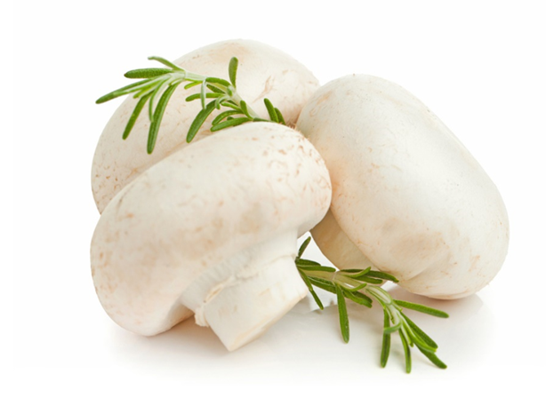

Recent advances in quality preservation of postharvest mushrooms ( Agaricus bisporus ): A review
By：Ren Hao
Supervisor：Sun Bingxin
FOOD SCIENCE COLLEGE OF SYAU
食品学院

Slide 2

A B S T R A C T
This review summarlses quality degradation processes of mushrooms including moisture loss, discolouration, texture changes, microbial count increasing, and nutrients and flavour loss, analyses their influential factors including temperature, relative humidity, water activity, and respiration rate, and presents the preservation methods for mushrooms including drying, cooling, packaging, irradiation, washing, and coating.
FOOD SCIENCE COLLEGE OF SYAU
食品学院

Slide 3
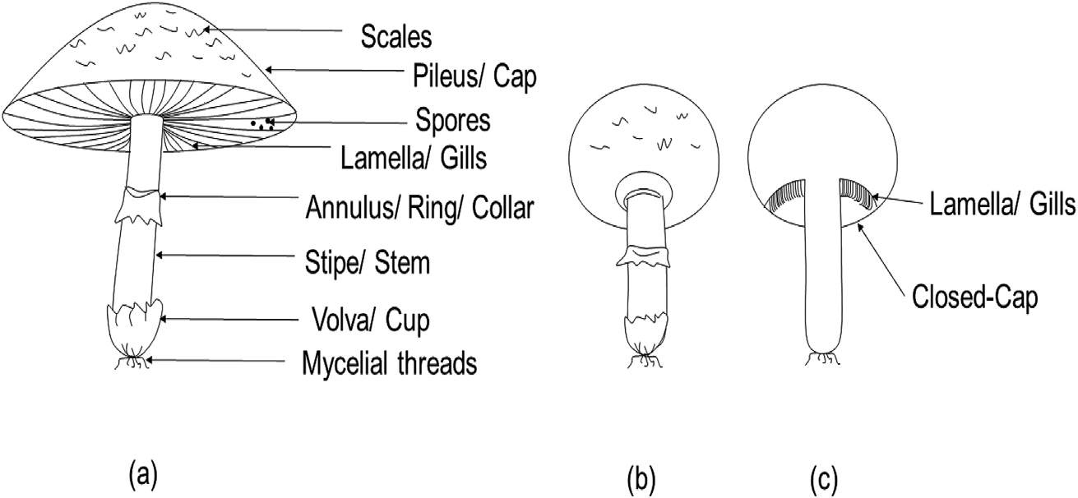
Morphology of Agaricus bisporus mushrooms at different maturity stages. (a) mature mushroom; (b) immature mushroom with a closed cap; (c) longitudinal slice of immature mushroom.
FOOD SCIENCE COLLEGE OF SYAU
食品学院

Slide 4
01
Quality degradation of mushrooms
02
Influential factors on mushrooms quality
03
Preservation methods
FOOD SCIENCE COLLEGE OF SYAU
食品学院

Slide 5
01
Quality degradation of mushrooms
FOOD SCIENCE COLLEGE OF SYAU
食品学院

Slide 6

1.Moisture loss
Quality degradation occurs in mushrooms during the postharvest period. The most significant quality changes are moisture loss, discolouration, texture softening, nutrients and flavour loss.
4.Nutrients and flavour loss
Quality degradation of mushrooms
2.Discolou-ration
3.Texture changes
FOOD SCIENCE COLLEGE OF SYAU
食品学院

Slide 7

1.Moisture loss
The moisture content of fresh Agaricus bisporus is of 85%–95%. Weight losses of the mushrooms stored at 4 ℃ for 2, 7 and 12 days were reported as 0.07%, 0.27% and 0.49%。This physiological process speeds up mushrooms quality degradation.
FOOD SCIENCE COLLEGE OF SYAU
食品学院

Slide 8
2.Discolouration
The surface of white mushrooms is prone to brown due to microbial contamination or enzymatic activities. Enzyme activities are main reason. PPO is considered to be the main contributor affecting postharvest browning on Agaricus bisporus. Among the PPO families, tyrosinase is the responsible enzyme for Agaricus bisporus browning because of its high content in mushrooms. Generally, the PPO catalyses the reaction of phenolic compounds in two steps: (1) hydroxylation of monophenols into diphenols, (2) oxidation of phenolic substance into quinones.
FOOD SCIENCE COLLEGE OF SYAU
食品学院

Slide 9
3.Texture changes
Mushrooms’ postharvest texture profile is affected by water loss, wound and mechanical injury, as well as heat treatments. Different from other fruits and vegetables, mushrooms lack a pectin structure. The cell wall of mushrooms mainly consists of glucans, chitin and protein. During the heat treatment, the chitin and β-1, 4-acetyl-glucosamine homopolymer form a stiff microfibril structure, which enhances the strength of mushrooms cell wall. As a result, hardness and chewiness of mushrooms increased during drying.
FOOD SCIENCE COLLEGE OF SYAU
食品学院

Slide 10

4.Nutrients and flavour loss
Mushrooms are rich in protein in their dry matter, containing nine essential amino acids. In addition, mushrooms are low in fat and have a relatively high content of carbohydrates and fibre. There are 14.1% protein, 2.2% fat, 9.7% ash and 74%carbohydrates in Agaricus bisporus (dry basis). Special aroma and flavour are presented in mushrooms, including both volatile and non-volatile components such as soluble sugars, polyols, free amino acids, organic acids and 5′-nucleotides, and monosodium glutamate (MSG).
FOOD SCIENCE COLLEGE OF SYAU
食品学院

Slide 11
02
Influential factors on mushrooms quality
FOOD SCIENCE COLLEGE OF SYAU
食品学院

Slide 12

Water activity
Internal factors
Respiration rate
Microbial activity
Influential factors
Storage temperature
External factors
Relative humidity
Mechanical damage
FOOD SCIENCE COLLEGE OF SYAU
食品学院

Slide 13

Internal factors
1.Water activity
A nature high aw of fresh mushroom can provide ideal environment for microbial growth.
2. Respiration rate
Respiration is a metabolic process, during which the plant consumes oxygen and releases carbon dioxide. During mushrooms aerobic respiration procedure, various substrates such as carbohydrate, lipids and organic acids in mushrooms was broken down to simple molecules, like CO2 and water.
3. Microbial activity
Commercially, the technique used for cultivation of Agaricus bisporus relys on composting. Therefore, mushrooms are likely to expose to various microorganism, having a high possibility of being contaminated A large microbial population significantly disrupts mushrooms quality by causing browning, blotchy and deterioration.
FOOD SCIENCE COLLEGE OF SYAU
食品学院

Slide 14
External factors
1. Storage temperature
Generally, increasing the storage temperature accelerates mushrooms’ senescence, browning, weight loss as well as texture softening. Low and constant temperature (above 0 ℃) was recommended for mushroom postharvest storage, as chilling injury would occur if the storage temperature below 0 ℃.
2. Relative humidity
A higher RH used in the storage conditions helps to minimize the mass loss in mushroom during postharvest. A high relative humidity level (85%–95%) should be maintained in any case.
3. Mechanical damage
Mechanical damage can induce surface bruise, cap colour changes and texture softening, leading to shelf life reduction of mushrooms
FOOD SCIENCE COLLEGE OF SYAU
食品学院

Slide 15
03
Preservation methods
FOOD SCIENCE COLLEGE OF SYAU
食品学院

Slide 16
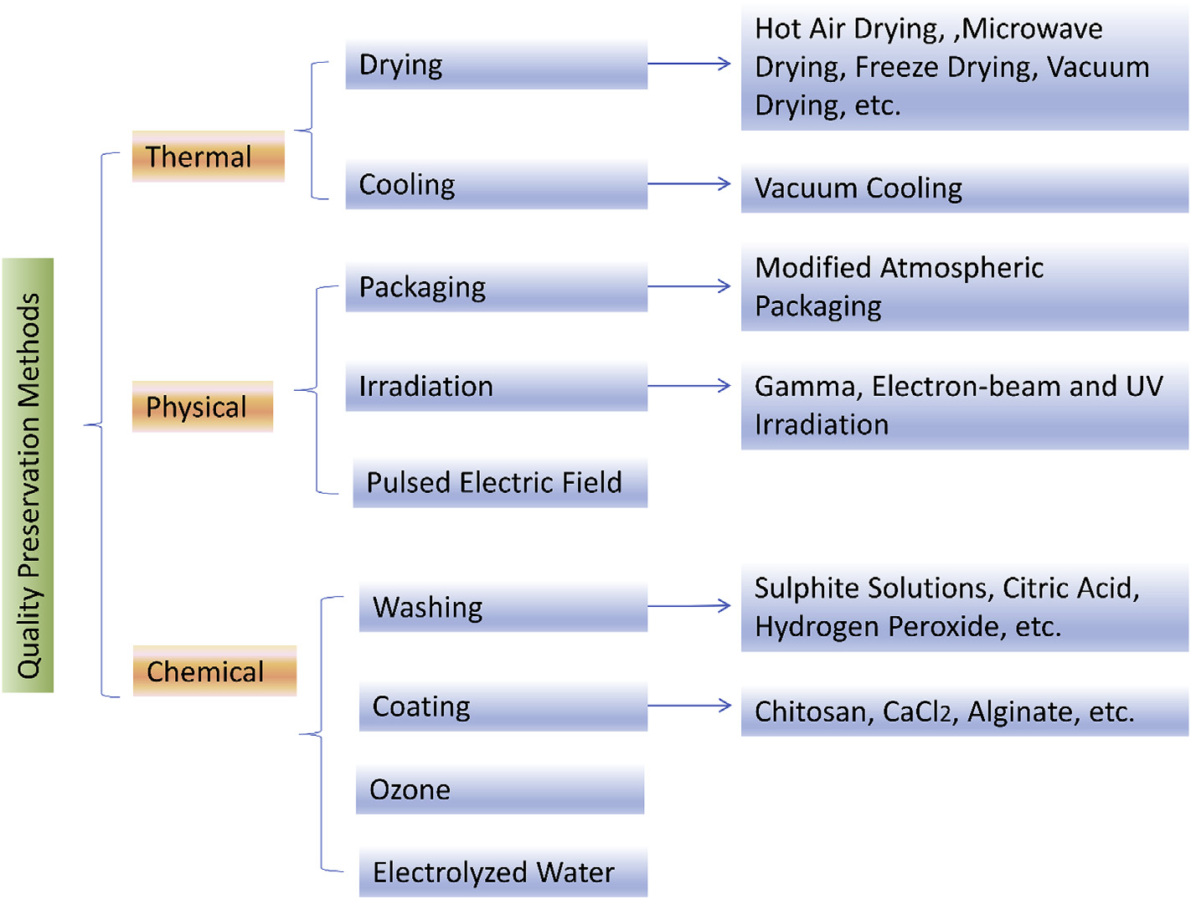
FOOD SCIENCE COLLEGE OF SYAU
食品学院

Slide 17

1.Thermal processes
1). Drying
Solar drying and hot air drying
Microwave vacuum drying
Microwave drying
Freeze drying (FD)
The frequency range from 300 MHz to 300 GHz, can significantly reduce the drying time.
Water is removed from the solid phase to vapour phase directly during the drying process. Heatsensitive properties of products such as vitamins could be maintained without heat damage.
Helped to produce more uniform dried products with a larger amount of tasteactive
amino acids residual.
FOOD SCIENCE COLLEGE OF SYAU
食品学院

Slide 18
1.Thermal processes
2). Cooling
Cooling
At 0 °C, mushrooms respiration rate is three times lower than that at 10 ℃.
Vacuum cooling
Compared to conventional cooling methods, vacuum cooling can reduce the mushroom cooling time significantly and can lower the microbial growth rate. The mass loss rate was about 5% in vacuum cooling and 9% in conventional cooling.
FOOD SCIENCE COLLEGE OF SYAU
食品学院

Slide 19
2.Physical processes
1. Packaging
Modified atmosphere packaging
A number of factors, such as the properties of the packaging materials, ambient gas composition, the surface area of the sample as well as storage temperature and humidity can influence the storage effect of MAP 。
Early study of Roy, Anantheswaran, and Beelman (1995) showed that the optimum inpackage O2 concentration that could reduce cap opening of mushrooms was 6%. When the O2 concentration in the package was lower than 2%, the growth of some anaerobic microorganisms。
The medium oxygen level（50% O2 and 50% N2）and film with higher permeability (polyethylene films with 39 μm thickness) were found to be the optimum MAP condition to prolong mushrooms shelf-life.
FOOD SCIENCE COLLEGE OF SYAU
食品学院

Slide 20
2.Physical processes
2). Irradiation
Gamma irradiation
UV irradiation
electron-beam
It have an effect on diminishing enzymatic browning by retarding the polyphenol oxidase activities in mushrooms. However, the use of gamma irradiation could cause variation in chemical composition of mushrooms.
For ultraviolet-C (UVeC) treatment, Guan et al. (2013) investigated the effect of UV-C on microbial loads of fresh button mushrooms during 21 days of storage at 4℃. A dose of 0.45–3.15 kJm−2 UV-C irradiation
resulted in 0.46–1.13 log CFU/g reduction of E. coli 0157:H7 and
0.63–0.89 log CFU/g reduction of total aerobic plate counts on the cap
of mushrooms.
Irradiation level of 1 kGy
have a positive effect on shelf-life extension of mushroom slices, by reducing aerobic and psychrotrophic populations.
FOOD SCIENCE COLLEGE OF SYAU
食品学院

Slide 21

2.Physical processes
3). Pulsed electric field and ultrasound
Pulsed electric field
Ultrasound
The use of short pulses of electricity in PEF treatment can inactivate microorganisms and enhance the mass transfer process. In PEF, the electric field strength creates
transient pores in biological membranes, leading to irreversible cell disruption.
Ultrasound assisted hot air drying can achieve high drying efficiency by enhancing water
transportation in fruits and vegetables
A combination of low concentration
acidic electrolyzed water and ultrasound are proved as an effective
method for retarding enzymatic browning and firmness maintenance
infresh mushroom slices
FOOD SCIENCE COLLEGE OF SYAU
食品学院

Slide 22
3.Chemical processing
1）. Washing with antimicrobial agents
Chemicals such as antimicrobial agents are generally added to the washing water to remove casing soil and to diminish mushrooms quality deterioration. Gupta and Bhat (2016) 2.5% citric acid was the most effective solution for mushroom quality preservation.
The use of 3% H2O2 as a washing agent on mushrooms before UV-C irradiation could achieve a microbial reduction of up to 0.85 log CFU/g and showed the best performance in inhibiting mushrooms lesion and browning. Guan et al. (2013)
FOOD SCIENCE COLLEGE OF SYAU
食品学院

Slide 23
3.Chemical processing
2). Coating
1.Alginate is a kind of edible coating substrate extracted from brown algae. dipped mushrooms with 2% alginate for 2 min then stored the coated mushrooms in jars that were ventilated with 100% oxygen. This treatment helped to maintain the firmness of mushrooms, to delay discolouration and cap opening and to inhibit the loss of soluble solids concentration, total sugars and ascorbic acid of mushrooms. The shelf-life of mushrooms was successfully extended to 16 days.
2. Chitosan ：As reportedby Jiang, Feng, and Li (2012), treatment with chitosan-glucose complex coating maintained tissue firmness, reduced microbial counts and inhibited increase of respiration rate in mushroom (lentinus edodes) within 16 days of storage at 4 °C.
FOOD SCIENCE COLLEGE OF SYAU
食品学院

Slide 24
Chemical processing
3）.Ozone
Ozone, also called triatomic oxygen, is a powerful antimicrobial agent to extend shelf-life of food. Due to the strong oxidation capacity, ozone inactivates microorganisms rapidly after reacting with intercellular enzymes and cell components.
FOOD SCIENCE COLLEGE OF SYAU
食品学院

Slide 25
Chemical processing
4）. Electrolyzed water
Electrolyzed water (EW) is another promising disinfectant generated by electrolysis of a salt solution. Compared to other disinfectants, EW treatment has less aggressive corrosion on food quality. Aday (2016) The use of 25 mg L−1 EW had the best performance in maintaining mushrooms whiteness index and texture, and diminishing weight loss.
FOOD SCIENCE COLLEGE OF SYAU
食品学院

Slide 26
Challenges and future trends
Drying
Texture changes and discolouration
Vacuum cooling
High capital cost
Irradiation
Specified range
The application of some novel techniques and the combination of different techniques with a low capital cost or less processing time should be encouraged to further enhance mushrooms postharvest quality.
FOOD SCIENCE COLLEGE OF SYAU
食品学院

Slide 27
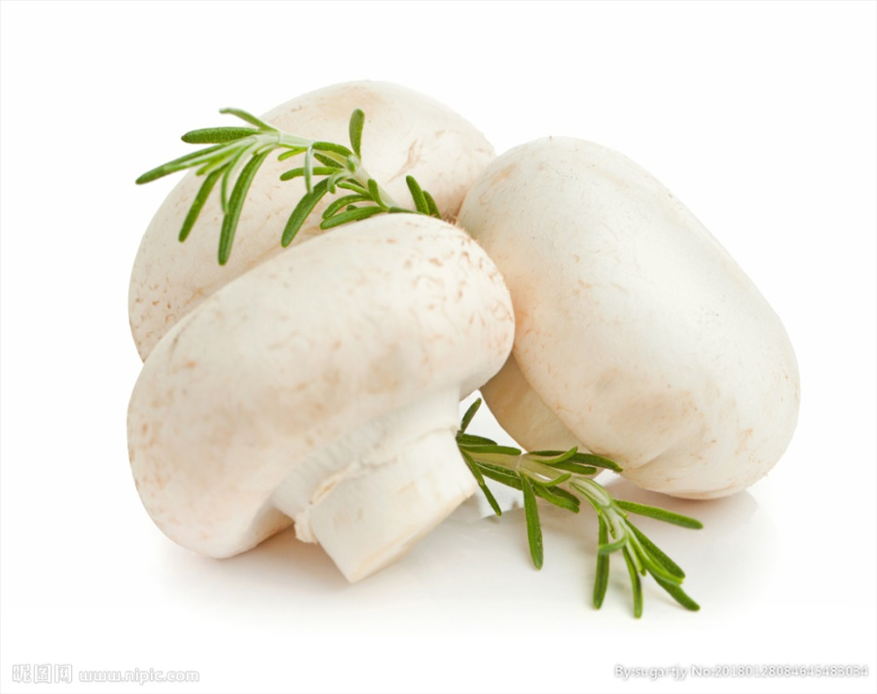
THANK YOU !
FOOD SCIENCE COLLEGE OF SYAU
食品学院

